Slide 1
Introduction to Robotics
CSE 461
Lecture 12: Introduction to Machine Learning and Neural Networks
Niloy Irtisam
Lecturer, Dept. of Computer Science and Engineering
Brac University

Slide 2
Tumor Size | Condition
10 | malignant
2 | benign
1 | benign
5 | malignant

Slide 3
Tumor Size | Condition
10 | malignant
2 | benign
1 | benign
5 | malignant

Slide 4
Tumor Size | Condition
10 | malignant
2 | benign
1 | benign
5 | malignant

Slide 5
Tumor Size | Condition
10 | malignant
2 | benign
1 | benign
5 | malignant
4

Slide 6
Tumor Size | Age | Condition
10 | 50 | malignant
2 | 30 | benign
1 | 45 | benign
5 | 40 | malignant

Slide 7
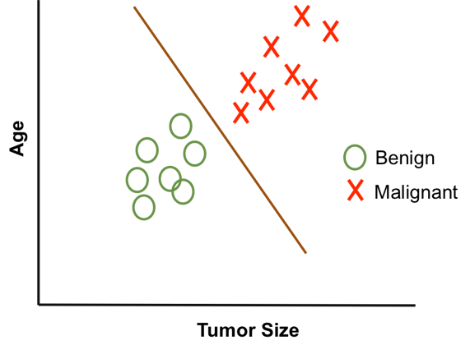
Tumor Size | Age | Condition
10 | 50 | malignant
2 | 30 | benign
1 | 45 | benign
5 | 40 | malignant

Slide 8
Tumor Size | Age | Condition
10 | 50 | malignant
2 | 30 | benign
1 | 45 | benign
5 | 40 | malignant
0.9*10 + 0.1*50 = 9 + 5 = 14

Slide 9
Tumor Size | Age | Condition
10 | 50 | malignant
2 | 30 | benign
1 | 45 | benign
5 | 40 | malignant
0.9*10 + 0.1*50 = 9 + 5 = 14
0.9*2 + 0.1*30 = 1.8 + 3 = 4.8
0.9*1 + 0.1*45 = 0.9 + 4.5 = 5.4
0.9*5 + 0.1*40 = 4.5 + 4 = 8.5

Slide 10
Tumor Size | Age | Condition
10 | 50 | malignant
2 | 30 | benign
1 | 45 | benign
5 | 40 | malignant
0.9*10 + 0.1*50 = 9 + 5 = 14
0.9*2 + 0.1*30 = 1.8 + 3 = 4.8
0.9*1 + 0.1*45 = 0.9 + 4.5 = 5.4
0.9*5 + 0.1*40 = 4.5 + 4 = 8.5
6.5

Slide 11
Tumor Size | Age | Condition
10 | 50 | malignant
2 | 30 | benign
1 | 45 | benign
5 | 40 | malignant
Tumor Size = 9
Age = 42
6.5

Slide 12
Tumor Size | Age | Condition
10 | 50 | malignant
2 | 30 | benign
1 | 45 | benign
5 | 40 | malignant
Tumor Size = 9
Age = 42
0.9*9 + 0.1*42 = 8.1 + 4.2 = 12.3
6.5

Slide 13
Tumor Size | Age | Condition
10 | 50 | malignant
2 | 30 | benign
1 | 45 | benign
5 | 40 | malignant
Tumor Size = 9
Age = 42
0.9*9 + 0.1*42 = 8.1 + 4.2 = 12.3
malignant
6.5

Slide 14
x1
x2
y
Tumor Size | Age | Condition
10 | 50 | malignant
2 | 30 | benign
1 | 45 | benign
5 | 40 | malignant
w1 * x1 + w2 * x2 = y
0.9*9 + 0.1*42 = 8.1 + 4.2 = 12.3
malignant
6.5

Slide 15
x1
x2
y
Tumor Size | Age | Condition
10 | 50 | malignant
2 | 30 | benign
1 | 45 | benign
5 | 40 | malignant
w1 * x1 + w2 * x2 = y
x1, x2, ....., xn = Features
y = output/ target
w1, w2, ....., wn = Weights

Slide 16
x1
x2
y
Tumor Size | Age | Condition
10 | 50 | malignant
2 | 30 | benign
1 | 45 | benign
5 | 40 | malignant
w1 * x1 + w2 * x2 = y
Let w1 = 0.1 and w2 = 0.9
x1 = 2 and x2 = 5
0.1*2 + 0.9*5 = 0.2 + 4.5 = 4.7
benign

Slide 17
x1
x2
y
Tumor Size | Age | Condition
10 | 50 | malignant
2 | 30 | benign
1 | 45 | benign
5 | 40 | malignant
w1 * x1 + w2 * x2 = y
Let w1 = 0.1 and w2 = 0.9
x1 = 2 and x2 = 30
0.1*2 + 0.9*30 = 0.2 + 27 = 27.2
malignant

Slide 18
x1
x2
y
Tumor Size | Age | Condition
10 | 50 | malignant
2 | 30 | benign
1 | 45 | benign
5 | 40 | malignant
w1 * x1 + w2 * x2 = y
Let w1 = 0.1 and w2 = 0.9
x1 = 2 and x2 = 30
0.1*2 + 0.9*30 = 0.2 + 27 = 27.2
malignant
Weights are very important.

Slide 19
Size(sq-feet) | Bedroom | Kitchen | Main road | Balcony | Price(dollar)
1600 | 4 | 1 | 0.2 | 2 | 20000
1400 | 3 | 1 | 0.5 | 1 | 12000
1600 | 2 | 1 | 0.2 | 2 | 10000
2000 | 4 | 2 | 0.1 | 3 | 43000

Slide 20
x1
x2
x3
x4
x4
y
Size(sq-feet) | Bedroom | Kitchen | Main road | Balcony | Price(dollar)
1600 | 4 | 1 | 0.2 | 2 | 20000
1400 | 3 | 1 | 0.5 | 1 | 12000
1600 | 2 | 1 | 0.2 | 2 | 10000
2000 | 4 | 2 | 0.1 | 3 | 43000

Slide 21
x1
x2
x3
x4
x4
y
Size(sq-feet) | Bedroom | Kitchen | Main road | Balcony | Price(dollar)
1600 | 4 | 1 | 0.2 | 2 | 20000
1400 | 3 | 1 | 0.5 | 1 | 12000
1600 | 2 | 1 | 0.2 | 2 | 10000
2000 | 4 | 2 | 0.1 | 3 | 43000
w1 * x1 + w2 * x2 + ….. + w4 * x4 = y

Slide 22
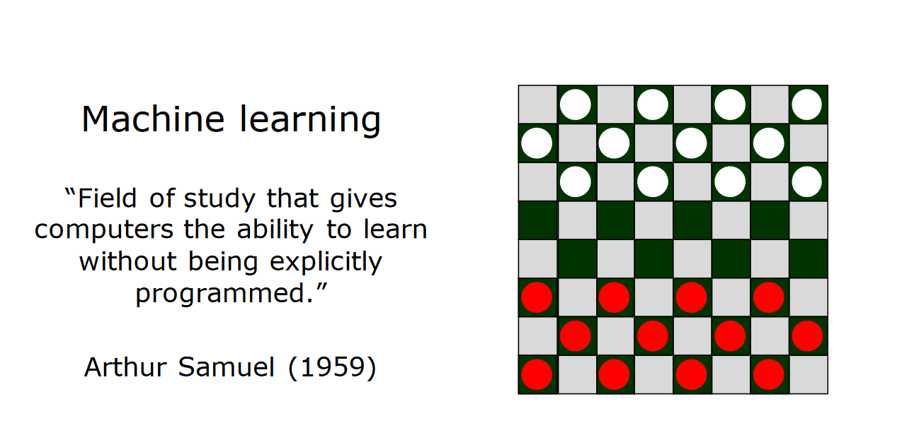

Slide 23
Two Types
Regression
Classification

Slide 24
What if x3 is not important?
w1 * x1 + w2 * x2 + w3 * x3 = y

Slide 25
What if x3 is not important?
w1 * x1 + w2 * x2 + w3 * x3 = y
Simply set w3 = 0
w1 * x1 + w2 * x2 = y

Slide 26
Mother Law of Machine Learning
w1 * x1 + w2 * x2 + w3 * x3 = y

Slide 27
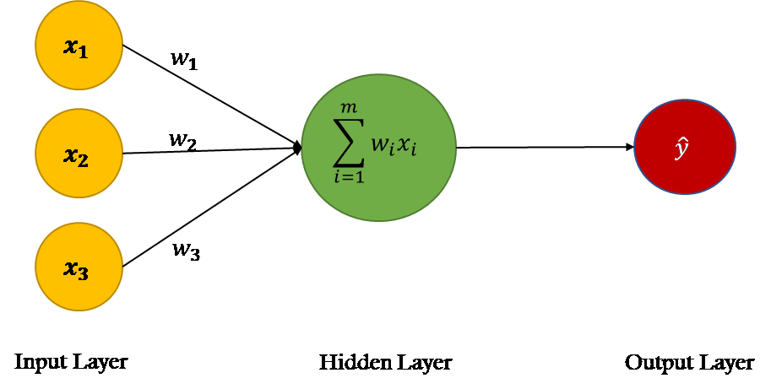
Mother Law of Machine Learning
w1 * x1 + w2 * x2 + w3 * x3 = y

Slide 28
Mother Law of Machine Learning
w1 * x1 + w2 * x2 + w3 * x3 = y

Slide 29
Mother Law of Machine Learning
w1 * x1 + w2 * x2 + w3 * x3 = y

Slide 30
Neural Network
w1 * x1 + w2 * x2 + w3 * x3 = y

Slide 31
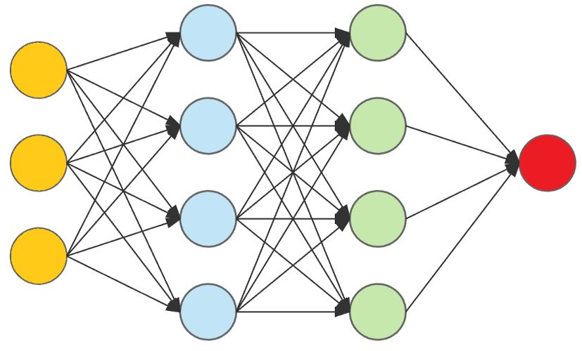
Neural Network

Slide 32
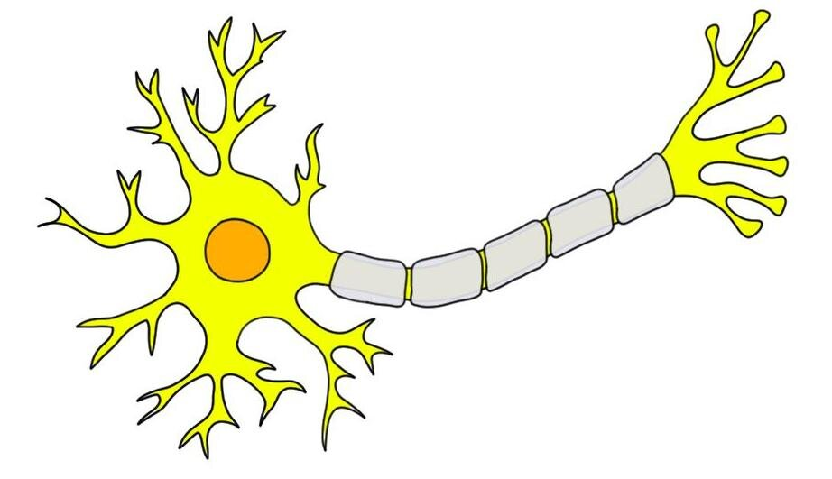
Human Brain
Decision
Informations

Slide 33
Machine Brain
Decision
Informations

Slide 34
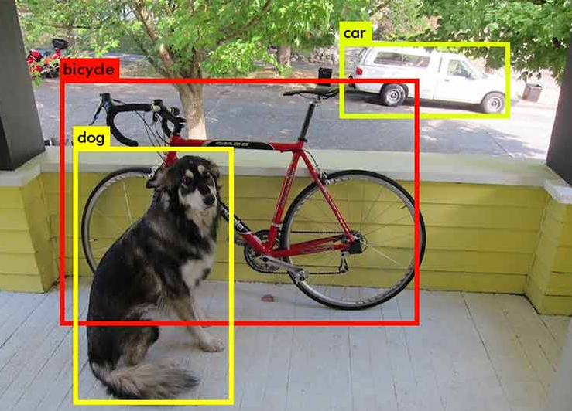
Next Class
Object Detection using Machine Learning

Slide 35
THANK YOU

